Slide 1
Lesson #2
Functions and Loops
Algorithms
Messaging
Troubleshooting and debugging

Slide 2
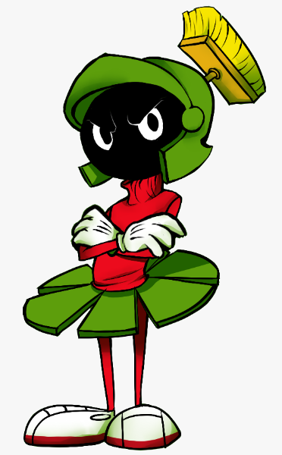


Test #1
Write the python code for Mr Martian to get the drill from the toolbox.
Alien from Planet Python needs a drill to fix his spacecraft.
You have a drill in your toolbox that you can lend him.
BUT he only speaks Python language.
How will you let him know he can borrow your drill?
Hint: from gpiozero import LED
TOOLBOX
DRILL

Slide 3
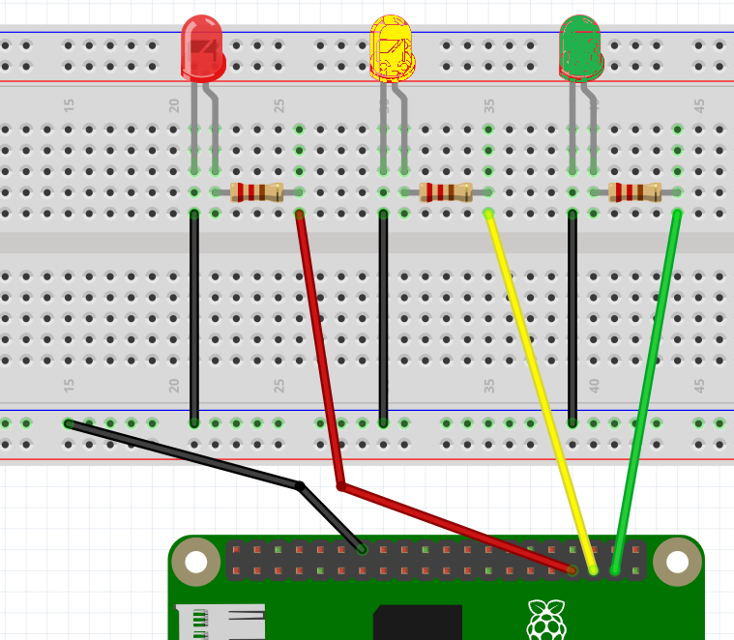


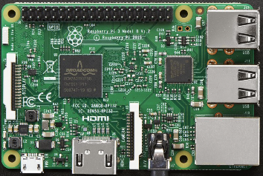

EXERCISE #2
Wiring for a Traffic Light
GROUND
PIN 13
PIN 19
PIN 26

Slide 4
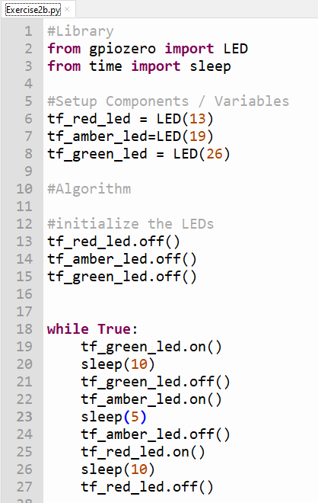
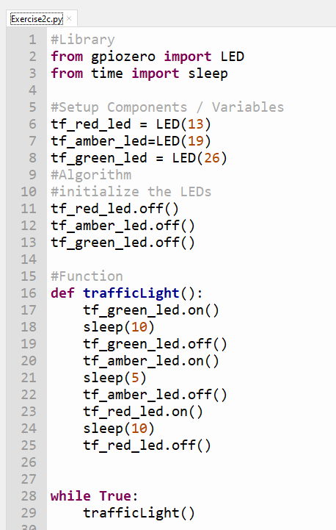
WEEK 2
Ex. 2b Traffic Light in a Loop (Exercise2b.py)
Ex. 2c Traffic Light as a Function (Exercise2c.py)
Functionalize

Slide 5
Test #2
Use your blue and red LED to make the flashing lights on a patrol car
Choose any pin you wish
Wire up the circuit and write the python code to make it work

Slide 6


Exercise 3 – Wiring a Pedestrian Crossing
-VE
+VE
GROUND
PIN 14
PIN 18
PIN 24
PIN 25

Slide 7
TESTING OUR CIRCUIT USING THONNY SHELL
Ex 3a. Turning our Buzzer on
>>> from gpiozero import Buzzer
>>> buzz= Buzzer(25)
>>> buzz.on()
Ex 3b. Turning it off
>>> buzz.off()
Ex 3c. Make it blink – 1 sec on 1 sec off
>>> buzz.blink()
Ex 3d. Make it pulsate a number of times
>>> buzz.blink(on_time=.5, off_time=.8, n=5)

Slide 8
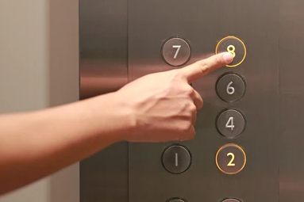
THE UBIQUITOUS BUTTON
THEY MOVE THE WORLD AROUND US
THEY WORK ROUND THE CLOCK
NOTHING GETS DONE WITHOUT THEM
THEY ARE OUR INTERMEDIARIES
WE PRESS THEM ALL THE TIME, YET THEY ARE PATIENT

Slide 9
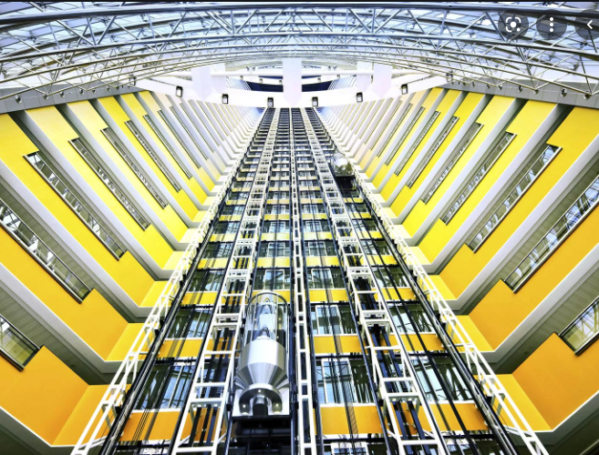

REAL WORLD
HUMANS CANNOT DIRECTLY INTERACT WITH ELEVATOR SYSTEM
INTERACTION BETWEEN HUMANS AND THE REAL WORLD VIA A COMPUTER SYSTEM
ELEVATOR CONTROL SYSTEM
US HUMANS

Slide 10
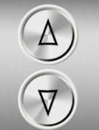
REAL WORLD
HUMANS CANNOT DIRECTLY INTERACT WITH ELEVATOR SYSTEM
INTERACTION BETWEEN HUMANS AND THE REAL WORLD VIA A COMPUTER SYSTEM
ELEVATOR CONTROL SYSTEM
US HUMANS

Slide 11
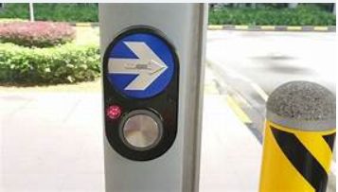
Exercise 3 – Wiring a Pedestrian Crossing
-VE
+VE
GROUND
PIN 14
PIN 18
PIN 24
PIN 25

Slide 12
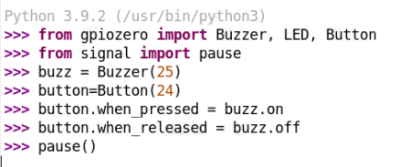

TESTING OUR CIRCUIT USING THONNY SHELL
Ex 3e. Button Activating/Deactivating Buzzer
Ex 3f. Button Activating / Deactivating Red LED (Pin 14)
Can you make it Blink too?

Slide 13
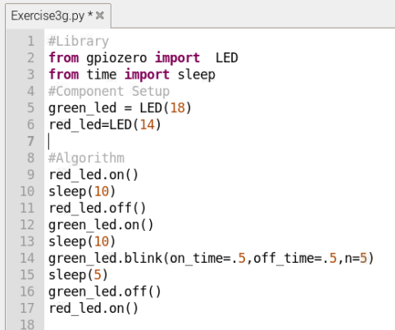
Ex. 3g Pedestrian Crossing Program – Version 1
Save program as Exercise3g.py
ALGORITHM FOR A PEDESTRIAN CROSSING
STARTS WITH RED
AFTER 10 SECONDS
RED GOES OFF
GREEN COMES ON
AFTER 10 SECONDS
GREEN BLINKS FIVE TIMES
AFTER 5 SECONDS
GREEN GOES OFF
RED COMES ON

Slide 14
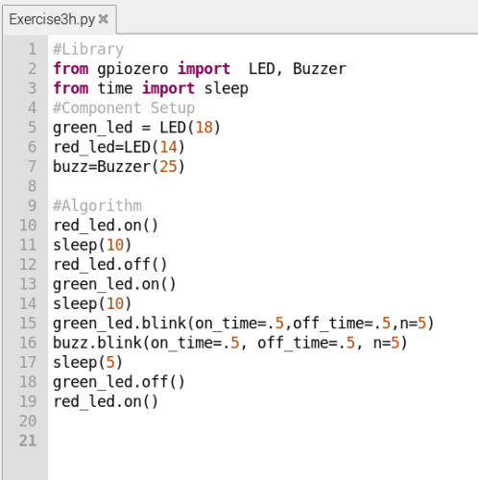
Ex. 3h Pedestrian Crossing Program – Version 2 – With Buzzer
Save program as Exercise3h.py
ALGORITHM FOR A PEDESTRIAN CROSSING
STARTS WITH RED
AFTER 10 SECONDS
RED GOES OFF
GREEN COMES ON
AFTER 10 SECONDS
GREEN BLINKS FIVE TIMES
BUZZER BLINKS FIVE TIMES
AFTER 5 SECONDS
GREEN GOES OFF
RED COMES ON

Slide 15
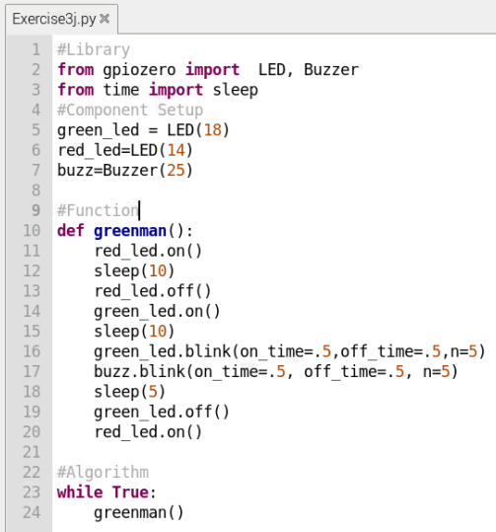
Ex. 3j Pedestrian Crossing Program – Version 3 – Introducing a Function
Save program as Exercise3j.py
ALGORITHM FOR A PEDESTRIAN CROSSING
STARTS WITH RED
AFTER 10 SECONDS
RED GOES OFF
GREEN COMES ON
AFTER 10 SECONDS
GREEN BLINKS FIVE TIMES
BUZZER BLINKS FIVE TIMES
AFTER 5 SECONDS
GREEN GOES OFF
RED COMES ON

Slide 16
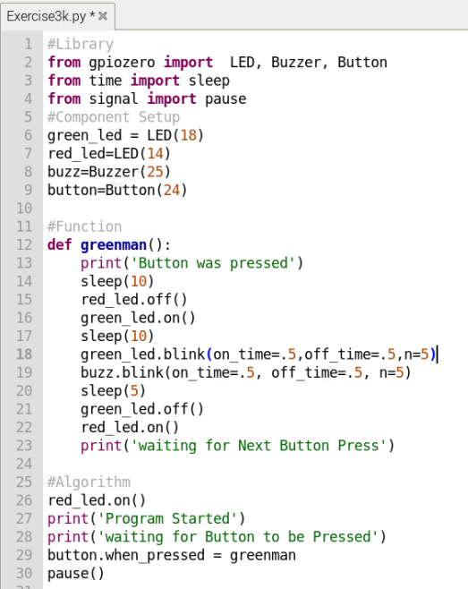
Ex. 3k Pedestrian Crossing Program – Version 4 – Add a Button
Save program as Exercise3k.py
ALGORITHM FOR A PEDESTRIAN CROSSING
STARTS WITH RED ON
WHEN BUTTON IS PRESSED
ACTIVATE Function greenman()

Slide 17
The gpiozero Library
Documentation
Messaging
Troubleshooting and debugging

Slide 18
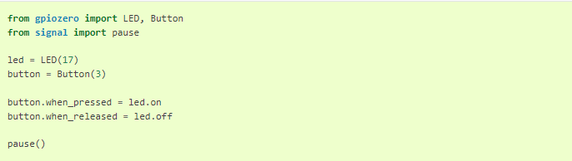
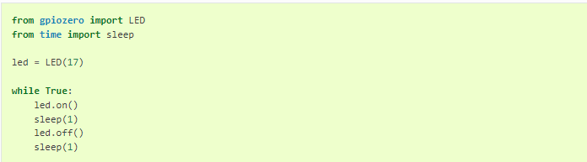
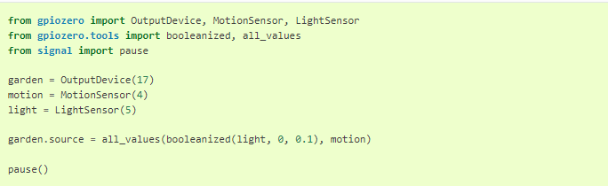
The gpiozero Library : Online Documentation
https://gpiozero.readthedocs.io/en/stable/
Demonstration of Basic Recipes - Examples

Slide 19
Messaging
Troubleshooting and debugging
Types of Errors

Slide 20
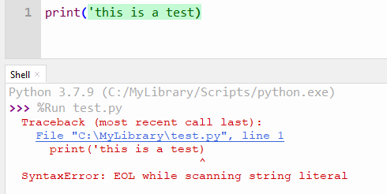
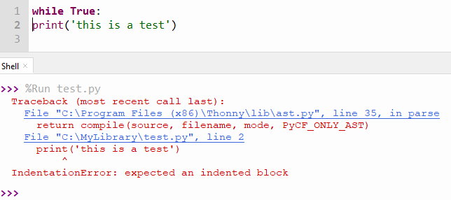
Types of Errors and how to debug Errors
Syntax Error
Convention Error – (indentation for Python)

Slide 21

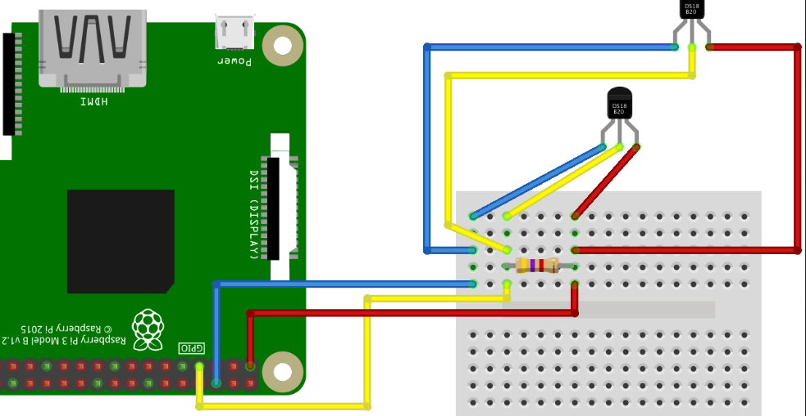
Types of Errors and how to debug Errors
Logical Error
Program is not working in the way you wanted
Circuitry Error
Wiring not done correctly
Wrong Pin used

